Slide 1
• WE ARE CURRENTLY ADMITTING PARTICIPANTS •
• PLEASE MUTE YOURSELF UNTIL INVITED TO SPEAK •
MORhomes Plc
Annual General Meeting and
Shareholder video conference
5 September 2024

Slide 2
Agenda
11.00 | Welcome (to include AGM formal business) | Neil Hadden, Chair, MORhomes
11.10 | Update on MORhomes business | Andrew Morton, CEO, MORhomes
11.25 | Market update | Zachary Kiefer, Chatham Financial
11.45 | Close

Slide 3
WELCOME (including AGM formal business)
NEIL HADDEN, CHAIR

Slide 4
Proxy votes received
Resolution | Votes
1. Annual Report and Financial Statements to 31 March 2024 adopted | For: 100%
2. PwC appointed as auditor and Directors authorised to set fees | For: 100%
3. Directors may allot securities up to £2,100,000 nominal amount | For: 100%
Reappointments:
4. Malcolm Charles Cooper | For: 100%
5. Neil John Hadden | For: 100%
6. Jane Elizabeth Pilcher | For: 100%
7. Geraldine Lesley Howley | For: 100%
8. Anjila Thomas | For: 100%
9. Michael Thomas Hinch | For: 100%
10. Andrew David Morton | For: 100%
Special Resolutions:
11. Directors empowered to allot securities (conferred by resolution 3) as if section S561(1) of the Companies Act 2006 did not apply | For: 100%

Slide 5
Update on MORhomes Business
ANDREW MORTON, CHIEF EXECUTIVE
** Confidential to MORhomes shareholders**

Slide 6
Highlights of the year 2023-2024
Building financial strength
Financial result excl one-offs ahead of budget, loss more than halved
Operating costs below budget
Further improvement planned, on path to profitability
Bottom line profit over £1m, growing total equity by 28%
Underlying loans performing strongly
Proving strength of business model
Unique benefits for borrowers
Established sound financial position
A ESG rating from MSCI
Seamless CEO transition
Patrick Symington retired at end of April 2023
Replaced by his deputy, Andrew Morton

Slide 7
Consistent Strategy
Improve investor spread
Build loan book
Build investor confidence
Build governance and operational excellence
More borrowers
Improve rating

Slide 8
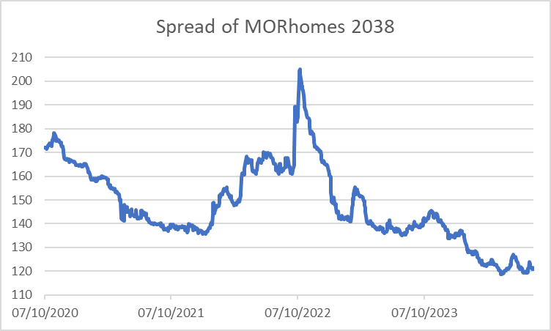
Bond spread at record low
Comparative secondary trading spread tightening
Absolute secondary spread has reached an all-time low recently
Strong demand for MH bonds - reverse enquiries / new investors
Enables taps close to / inside secondary trading price

Slide 9
Outlook
Borrowers responding to change / seeking to maintain financial strength
Bank of England (BoE) has started to lower Base Rate
Further BoE rate cuts expected
Rate cuts already built into gilt yields
Further drops in gilt yield need more BoE cuts than expected
New government making positive noises
Ambitious target for new homes
Media reports of future rent settlement
Challenges ahead
Fiscal decisions could alter gilt issuance, and thereby gilt yield
Political pressure to deliver
Competing priorities (affordability, stock investment, new development)
Cost inflation
Expect a shift back towards LT funding

Slide 10
Unique benefits of MORhomes
Speed and efficiency of borrowing
Minimal business covenants
Cash up-front, a year to perfect security
Security flexibility
Standby liquidity at minimal cost – similar to a “shelf” facility
£10m minimum issuance amount – loan size potentially smaller
Fixed interest rate, no swaps required
The sector’s own vehicle, here for the long-term
The right choice for 22 borrowers to date!
Offer very relevant in current market conditions

Slide 11
Questions

Slide 12
Contact MORhomes
www.morhomes.co.uk
02030110945
admin@MORhomes.co.uk

